Slide 1
Session 11:
Effective
Communication in Routine Immunization
Notes:
Kindly add scripts here

Slide 2
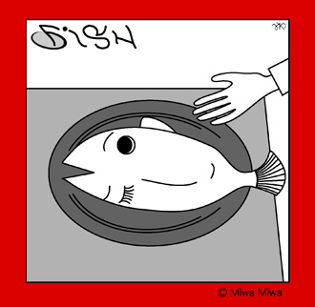
What is this?

Slide 3
What are important communication skills
for building up good relationship with your community?

Slide 4
Excellent Listener!
How Can We Improve Listening Skills
Eliminate distractions
Concentrate
Focus on the speaker
Maintain an open mind
Look for nonverbal cues
Show interest or empathy with people
Do not react to emotive words
Ask questions
Sit so you can see & hear
Avoid prejudices
Take mental or written notes
Ask for clarification

Slide 5
Effective communication Habits
Effective
Communication Habits
Bad
communication Habits
Supporting
Encouraging
Listening
Accepting
Trusting
Respecting
Negotiating differences
Criticizing
Blaming
Complaining
Nagging
Threatening
Punishing
Denying

Slide 6
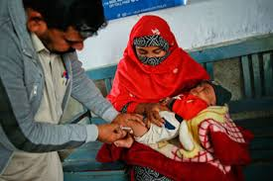
How to communicate with Caregivers?
Be respectful and compassionate
Provide reassurance
Use simple words and avoid technical terms
Listen to caregiver's concerns
Make sure the caregiver has understood your key messages

Slide 7
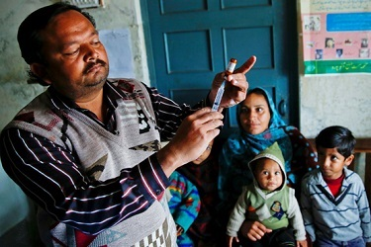
How to communicate with Caregivers?
Be respectful and compassionate
Be warm and welcoming
Show respect
Smile
Praise them for bringing their child for immunizations and encourage them to continue bringing their child until fully vaccinated.

Slide 8
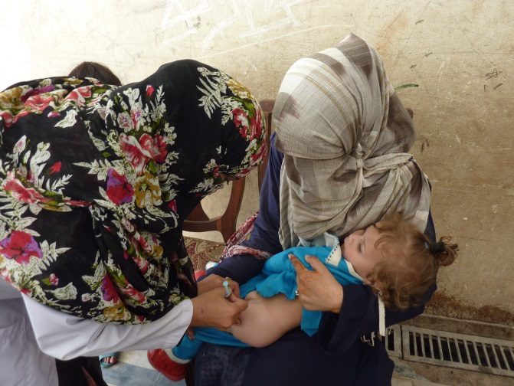
How to communicate with Caregivers?
Provide reassurance
Explain to parents and caregivers that vaccine is important and safe.
Reassure them that multiple injections are safe.
Remind them that it is better for the child to experience one, brief moment of discomfort than pain on two separate days.
Reinforce the importance of immunization overall

Slide 9
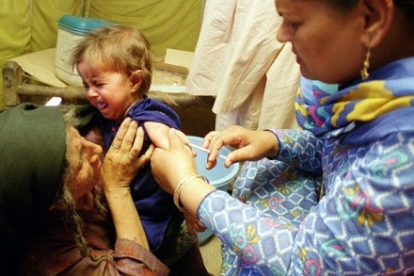
How to communicate with Caregivers?

Slide 10
How to communicate with Caregivers?
Listen to the caregiver's concerns
Allow the caregivers to talk, encourage them to ask questions
Give them your full attention
Listen to their concerns and respond to them politely. Correct any misconceptions they may have
Keep your body language positive
If you do not know the response to any question, tell the caregiver(s) that you will return with the correct information the next time you see them at the facility or outreach

Slide 11
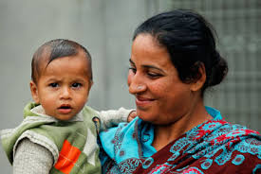
How to communicate with Caregivers?
Make sure the caregiver has understood your key messages
Explain and check for understanding – ask questions to find out if the caregiver understood you
Remind the caregiver to bring the child for the future vaccinations as per the schedule
Notes:
One

Slide 12
What Messages of Immunization are Effective?

Slide 13
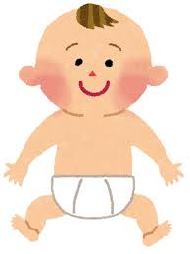
Why Immunization is Important?
Vaccines protect everyone
Directly: the person vaccinated, and
Indirectly: people who are vulnerable to disease, eg., babies, children, the elderly, people with a weak immune system
Vaccines keep
communities healthier

Slide 14
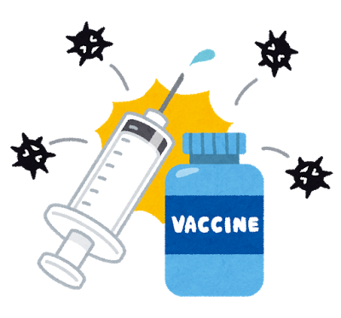




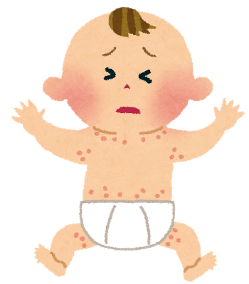

Explain: What is Immunizations ?
No immunized child
Immunized child
Whooping cough
HB
Measles
TB
Polio

Slide 15
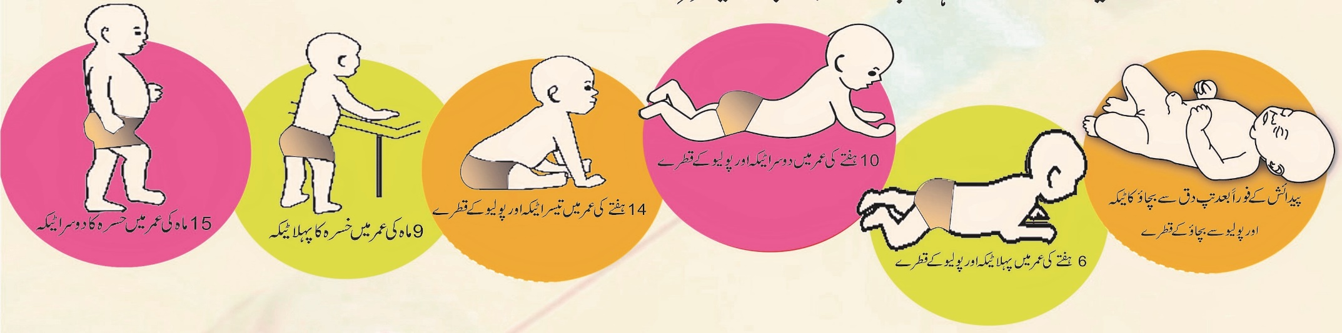
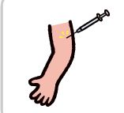

Explain Clear and Understanding Immunization Schedule
6th | 5th | 4th | 3rd | 2nd | 1st
15 months | 9 months | 14 weeks | 10 weeks | 6 weeks | After Birth
Measles 2 | Measles 1 | Penta 3 OPV 3 PCV 10 IPV | Penta 2 OPV 2 PCV 10 | Penta 1 OPV 1 PCV 10 | BCG OPV 0

Slide 16
Talking about the benefits of Multiple injections
Parents/caregivers may have concerns about their child receiving three vaccines at one visit. Health workers can address this by saying:
“Giving a child several vaccinations during the same visit allows your child to be immunized as soon as possible. They are protected against multiple diseases during the most vulnerable early months of life.”
“In addition, giving multiple vaccinations during the same visit means fewer visits for parents and caregivers. ”

Slide 17

Explain Caregivers about Side reaction
Most immunizations do not cause a reaction, but your child may develop a fever or
experience tenderness, swelling and redness where the injection was given.
Here are some ways to make your child more comfortable.
Give your child lots of cuddles and lots of fluids to drink.
if breastfeeding, give them lots of feeds.
Fever
If your child has fever, Don’t wrap in too much clothes.
Make sure the room is not too hot or too cold.
Using Cold sponging with tapped water.
Tenderness, swelling and redness at the injection site
Ice wrapped in a dry cloth, or a cooled cloth, can be held over the injection site
if it is sore.
Don’t rub the injection site. This can make the reaction worse.
Medication
• Give paracetamol only as advised by Health Staff

Slide 18
Messages of Routine Immunization towards Community
Vaccines save children’s lives
Vaccines are safe and effective: they can prevent cause permanent disability or even death
Vaccines save cost for medical expenses to prevent diseases.
Many vaccine-preventable diseases have no effective treatments
For some diseases, like tetanus, infection does not produce immunity: Vaccines produce immunity

Slide 19




Critical Message
The disease prevented by the vaccine administered
Minor side effects from the vaccine are normal, child will recover
When and where to come for the next vaccine – complete immunisation key for healthy child
The new vaccination card should be kept safely and brought on the next visit to the health centre
Notes:
To the facilitator:
Explain to the participants that this is the main information to keep in mind.
IPV is very safe and effective – and needed for polio eradication
It is safe to give multiple vaccine injections at one visit. Many countries have successfully introduced multiple vaccine injections into their routine immunization schedule
Health workers need to listen, understand, encourage and effectively communicate with caregivers to ensure that they

